Slide 1











Go/No-Go
Opportunity Assessment Multi-Tool
for evaluating product investment decisions
Value Proposition
Target
Market
Market
Size
Our Differentiator
Competitive
Landscape
Business Metrics/ Revenue Strategy
Go
Market Window
Go to Market Strategy
Solution Requirements
No Go
© 2023 theProductPath
Notes:
The Go/No-Go “Multi-Tool” is based on the Opportunity Assessment decision framework introduced by Marty Cagan and described in his book Inspired – How to create products people love

Slide 2








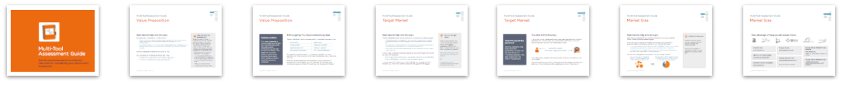
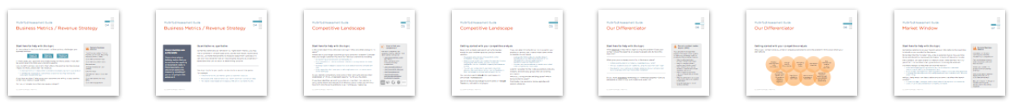










Contents
Overview
Title
9 Assessment Topics
1
Go/No-Go Slides
2
Assessment Guide
3
Full Reference Example
Tips & more from theProductPath
4
Notes:
What’s included in the Multi-Tool?
The 10 blank assessment topic slides are the core of the Multi-Tool
Uniquely designed for both capture and presentation
Easy to get started, optimized for ease-of-use
A title slide to introduce your main idea
Also, Instructions and Tips slides for getting the best results with the Multi-Tool
The latest version of the Multi-Tool includes this additional content:
Assessment Guide that provides assistance for each of the 10 topics
Complete Opportunity Assessment reference example
*TIP* Use PowerPoint’s Slide Sorter view for the Multi-Tool’s high-level organization
Titles help to distinguish each section:
Overview
Assessment Slides
Assessment Guide
Full Assessment Reference Example
Tips and more from theProductPath

Slide 3
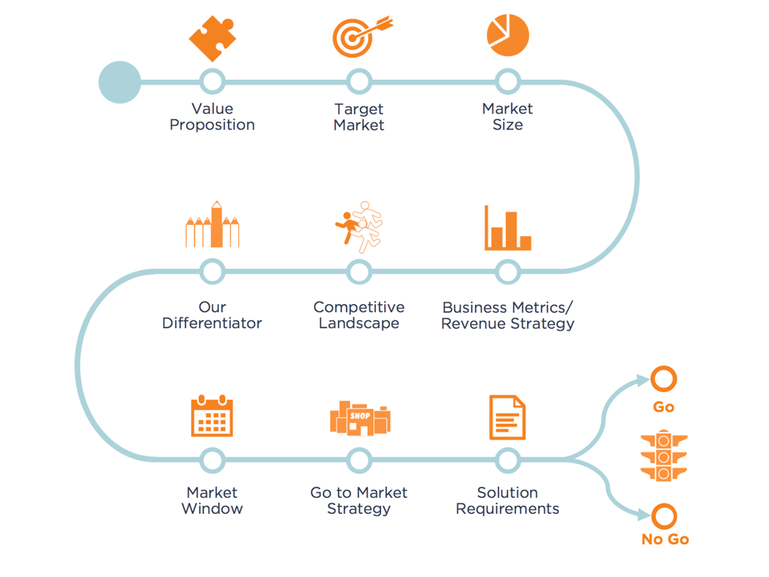
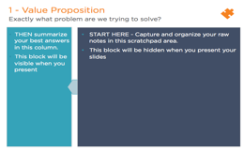
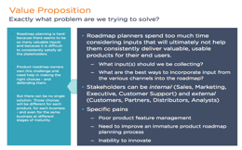
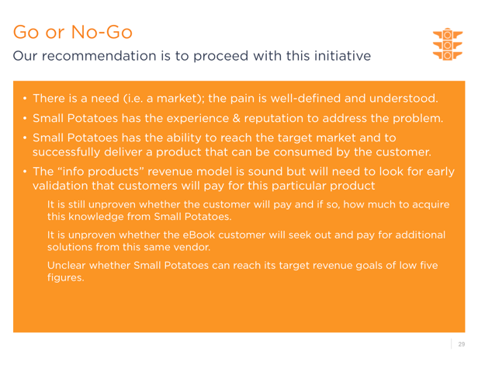
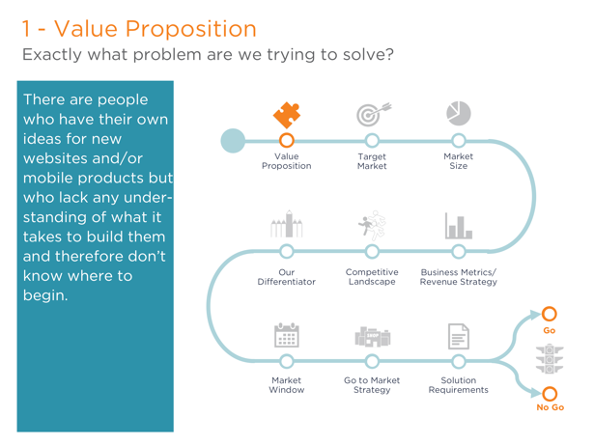
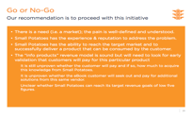



Using your Go/No-Go Assessment Multi-Tool
At any time, you can switch modes to view your beautiful presentation.
All your raw notes are hidden so the audience can focus on your answers.
The Assessment Tool has 9 questions leading up to the go/no-go decision.
You will find 9 corresponding slides here, one for each topic – plus one for the final go/no-go conclusion.
Fill out the boxes on each slide, capturing and distilling your notes.
Please switch to presentation mode to view this slide
Notes:
Flip back and forth month the worksheets as you organize your thoughts and capture your notes. You may find that you start by capturing thoughts on one topic, but then later realize they are more appropriate with another.
Before you get going, run the slide show in presentation mode so you can see how the presentation will be displayed.

Slide 4

[#] – [Assessment Topic]
[Prompter]
Step 2
Step 1
– !!! –
Please switch to
presentation mode
to view this slide
– !!! –
Companies struggle to meet aggressive recruiting goals
Existing process cannot scale
Internal resources are not adequate
Failing to acquire the necessary talent impacts many business goals and hinders company growth.
Companies struggle with their recruiting process, especially around aggressive hiring goals
Experiencing a hiring spike
  Company is having a growth spurt
    Need to hire multiple people over a shortened time period
  Higher-than-average hiring goals, if only for a limited time.
    Ramping up teams
    Expanding to new locations
Has no recruiting process
  No repeatable process, not a single transaction
  When the process of hiring is broken
  Current process is not meeting the hiring goals
Don't have a dedicated internal resource
  Interim gap
    Resource leaving
      Lose a recruiter
      Maternity leave
    Fired for bad results
  Wrong resource in place
    Firms may have recruiters but often it is a "process jockey", proactively calling people
    In some cases, the HR person might also be tasked with handling recruiting
    Active vs. passive
Cost containment?
  Paying too many fees to outside firms
Companies struggle with their recruiting process, especially around aggressive hiring goals
Experiencing a hiring spike
  Company is having a growth spurt
    Need to hire multiple people over a shortened time period
  Higher-than-average hiring goals, if only for a limited time.
    Ramping up teams
    Expanding to new locations
Has no recruiting process
  No repeatable process, not a single transaction
  When the process of hiring is broken
  Current process is not meeting the hiring goals
Don't have a dedicated internal resource
  Interim gap
    Resource leaving
      Lose a recruiter
      Maternity leave
    Fired for bad results
  Wrong resource in place
    Firms may have recruiters but often it is a "process jockey", proactively calling people
    In some cases, the HR person might also be tasked with handling recruiting
    Active vs. passive
Cost containment?
  Paying too many fees to outside firms
Create the presentation
Now use the Multi-Tool to present to your stakeholders.
Summarize your best responses in this smaller box on the left.
Try it now – switch to presentation mode to see the effect.
Take notes for a rough draft
Start by use the Multi-Tool just for note-taking.
Capture & organize all your raw ideas for each topic in this larger box on the right half of each slide.
The text in this box will be hidden when you present the slides. Click back to show them if needed.
EXAMPLE
Use the Guide
View notes for each slide or print the Guide to access a wealth of additional material for each topic.
Notes:
Need help with this topic?
Look here for additional support and expert guidance
Scroll through the text while viewing the slide…
OR print the Assessment Guide for the topic to see all the available reference material

Slide 6

1 - Value Proposition
Exactly what problem are we trying to solve?
Examples
Companies struggle to meet aggressive recruiting goals
Existing process cannot scale
Internal resources are not adequate
Failing to acquire the necessary talent impacts many business goals and hinders company growth.
Quick Help
Describe the problem only, not the solution.
Aim for stating the problem in 50 words or less.
Look to identify specific pain points, ideally problems that customers would be willing to pay to solve.
Review the complete Assessment Guide for more help with this topic.
Notes:
Common pitfalls
This is not necessarily a problem that your company has. If you find that you’re focusing on pains experienced by your own business, you may achieve better results using a different tool such as a formal business case, a SWOT analysis, or even a good ROI calculation worksheet.
Need help with this topic?
Describe only the problem, not the solution
There should be no reason to include anything about you, your product(s) or your business (you can make some of these connections in 6 – Our Differentiator)
Unless you caused or contributed to the actual problem, you should be able to describe some existing (customer) pain independently from your proposed solution
Aim for stating the problem in 50 words or less
You can begin by finishing sentences like these:
“Today, many [target users or businesses] struggle with …”
“A common issue that many [target users] face is…”
Still struggling? Try these brainstorming ideas:
Think of the kind of pain a company with this problem is experiencing
Try weaving in just how hard it is to solve this problem, or more specifically why the customer is not likely to have figured out their own solution.
What would solving the problem be worth to your customers? If possible, put a dollar figure on it. For example, “On average, SMB companies overpay for their XYZ each year by thousands of dollars.”
Take tips from the professionals
When you watch or listen to effective commercials, you will notice that they tend to start with pure problem statements. They look to establish some “pain” up front to help their audience self-identify. Only after the pain is identified (and often exaggerated or amplified) does the message switch to how to fix/resolve it. For example:
“I run my own business so I know how hard it is to find and hire the right people. There are so many job boards out there and …”
“Filing your taxes is hard…”
“Struggling to pay your bills?”
Assessment Guide | 1 of 10
Value Proposition

Slide 7

2 - Target Market
For whom do we solve that problem?
Examples
We are targeting B2B Sales people who themselves sell to Marketing departments.
Specifically:
A less experienced sales person
Carrying a high quota
And who calls or meets with a high volume of prospects each week
Quick Help
Create a detailed profile describing how to recognize your ideal prospect.
Combine with the original problem to create a problem hypothesis:
We believe that [target users] have a problem with [specific task(s)]
Review the complete Assessment Guide for more help with this topic.
Notes:
Sounds like personas…
Yes! If you decide to move forward with this opportunity, it is likely that the team will use the information gathered in this step to jump start their work on true personas.
Need help with this topic?
Create a detailed profile describing how to recognize your ideal prospect.
Choose the specific demographics that are important: age, location, gender, income level, education level, occupation, ethnic background, marital status, etc.
Your description may include the kind of business your prospect works for and should delineate the business' size in employees and revenue.
This profile will be helpful for determining the size of the total available market in the next topic.
It might help to identify particular subsets of your total target market that you are NOT targeting
E.g. All stay at home moms except those already selling products on eBay or Etsy
E.g. Any SMB based in the US, not including Hawaii or Alaska
In most cases, this is where you look to identify your paying customer. However, you may find it useful to separate the user from the buyer.
The other half of the story…
It is crucial that you understand your target user (and also your buyer, if separate). For the next topic, you must use this information captured here to help defined your true addressable market.
Your addressable market is the total number of these users that you can try to reach.
The more specific you can be in understanding your target customer, the better you’ll be at estimating the available population in the market.
Am I on the right track?
After you finish the first two topics, you should be able to build a solid Problem Hypothesis by filling in the blanks in statements like these with the answers you distilled.
We believe that [target users] have a problem with [specific task(s)]
Or
Our hypothesis is that [customer segment] struggles with [specific activity]
He has this problem
How many of him are out there
Assessment Guide | 2 of 10
Target
Market

Slide 8
3 - Market Size
How big is the opportunity?
Examples
$8B in hair and nail product retail sales annually in North America alone
The beauty industry claims roughly 86,000 salons in the US
The average salon schedules 7,000 appointments annually
If 80K salons make 7,000 annual appointments, there are over 50 million potential touch points just around that one scheduling activity
Quick Help
How many companies fit your profile outlined in your target market?
Is this market growing, stable, or shrinking?
Apply filters to a large data set OR roll up smaller data points to arrive at an estimate.
Review the complete Assessment Guide for more help with this topic.
Notes:
Need help with this topic?
How many companies fit your profile outlined in your target market? Think in terms of broad market appeal.
If you are able to determine whether the market your targeting is growing, stable, or shrinking, use this insight to build the case.
If you are targeting a niche market, be sure to highlight if that niche is growing (a good thing). How fast is it expected to grow in the next 1, 3, 5 years?
If your market is or will likely be shrinking in the future, tie this information to the “Why now?” topic later on in the Assessment.
There are two general approaches you can take to zero in on your target market:
You can work up to the desired target number by aggregating smaller, individual data points; “Find individual categories that fit your criteria and combine them to arrive at the final tally.” (missing source!)
You can start with the largest data set and apply successive filters to arrive at the most accurate collection.
Look to the Guide for more information about popular research tools.
Additional Resources
Look for published reports from any trade associations, industry analysts, and advocacy groups.
As you identify potential competitors, scour their own websites for existing market data.
Amazon.com
http://www.amazon.com
Google Keyword Tool
http://www.googlekeywordtool.com/
[requires Adwords account]
Google Trends
http://www.google.com/trends/
Google Global Market Finder
http://translate.google.com/globalmarketfinder/index.html?locale=en
Google Global Market Finder - Alibaba
http://www.alibaba.com/
useful for finding manufacturers and vendors
NAICS / SIC Code lookup
http://www.naics.com/search.htm
Software Industry Database
http://www.isvworld.com/
Assessment Guide | 3 of 10
Market
Size

Slide 9
4 - Business Metrics / Revenue Strategy
How will we measure success?
Examples
In the first 6 months, we intend to grow our customer base 2.5x.
We expect to see an improvement in our month-over-month conversion rates of 15% by end of year.
The total # of downloads will increase by 75% within the first 12 months.
Recurring annual revenue will reach $5M by Q3 2023.
Quick Help
Start with these three primary objectives:
Attracting customers
Retaining customers
Monetizing customers
If you have an idea of what price your customers are willing to pay, use that to identify a revenue-based metric.
Review the complete Assessment Guide for more help with this topic.
Notes:
Good metrics are actionable
There is little value in defining metrics that you do not have the capability or resources to capture. More importantly, you should not spend time measuring something if you’re not going to take action on it.
Need help with this topic?
An easy place to start is to think about the three primary challenges your business will face:
In most cases, your goal will be to make money for the business. If not, then be sure to state your alternative goal(s) here.
Look to define at least one metric that reflects the positive top line revenue impact for the business (net new revenue).
A revenue metric will measure that customers are actually paying for your product.
It will likely be measured as total contract value or as recurring revenue (for subscription-based offerings).
If you have an idea of what price your customers are willing to pay, use that to identify a revenue-based metric.
Can you anticipate more than one revenue stream?
You might try to tie your particular metrics to a certain time period. For example:
In the first 6 months, we intend to grow our customer base 2.5x.
We expect to see improvements in our month-over-month conversion rates of 15%.
The total # of downloads will increase by 75% within the first 12 months.
Quantitative vs. qualitative
Sometimes referred to as “left-brain” vs. “right-brain” metrics, you may find a combination of both types produces the best results. Quantitative metrics use mathematical terms to measure output from a process and can often be complemented with less tangible, less precise, observation-based data that can be better at determining outcome.
Sample Business Metrics
Total Contract Value (TCV) or
Monthly (or Annual) Recurring Revenue (MRR or ARR)
Customer conversion rate
Customer acquisition costs
Renewal rate
Average revenue per user (ARPU)
Lifetime value
Cancellation rate or Customer Churn
Customer satisfaction (e.g. NPS)
Customer engagement
Assessment Guide | 4 of 10
Business Metrics / Revenue Strategy

Slide 10

5 - Competitive Landscape
What alternatives are out there now?
Examples
Our customers are currently choosing to settle for crude email-based file sharing or adopting free, metered consumer-class software options.
The market leader is NXTSky who has been successfully converting new customers with a 14-day trial program.
Our customers are underserved by home-grown IT-driven remedies that take too long to build and are impossible to change.
Quick Help
What are others doing in this space?
Where else is your target customer going to solve their problem?
For each competitor, note their strengths and weaknesses – they may represent opportunity for your business.
Review the complete Assessment Guide for more help with this topic.
Notes:
Need help with this topic?
Is this a new idea? If not, who else is doing it? What are others doing in this space?
Where else is your target customer going to solve their problem? Consider that your target customer may have non-obvious alternatives including:
Doing nothing, procrastination, work-arounds, etc.
Do it yourselfers or those who choose to build vs. buy (e.g. custom, in-house solution);
Existing players in adjacent spaces that could easily move in to compete with you;
New players that don’t exist yet but who might jump into this market once it starts heating up.
As you identify competitors, note some of their strengths and also their weaknesses which could represent opportunity for your business.
If you have identified an existing solution or know that the customer is using some interim workaround, Rich Mironov cautions that you will likely have to fit into the same architecture as the thing your replacing.
Getting started with your competitive analysis
Begin with a simple web search using the top keywords for your problem space to yield the more prominent vendors.
Try several combinations of keywords to better triangulate the top players.
Make sure you qualify your results. For example, if you’re targeting the SMB market, you want to exclude companies that are themselves targeting the enterprise market.
You can use the top sites in your search results to discover alternative keywords; e.g. use the headings on their home page to uncover optimal search terms.
You can also search Linkedin for businesses and similar b2b “marketplaces”. Search for keywords/categories/companies on Google Trends to yield additional players.
If you can determine the SIC or NAIC codes for your product or service, use those to track down similar companies in your space.
Look up SIC/NAIC codes on sites like https://siccode.com/en or http://www.naics.com or on Wikipedia (http://en.wikipedia.org/wiki/Standard_Industrial_Classification)
You can then use siccode.com or similar sites to find other companies by those codes.
Look for websites for the trade associations, industry analysts, and advocacy groups that are covering your space.
Who is authoring articles and blog posts? Who is being invited to speak?
Find trade show sponsors, review agendas and session schedules.
How to find your competition
For each competitor, use research-oriented sites to track down similar companies
http://www.trustradius.com (e.g. http://www.trustradius.com/products/workday/competitors)
http://www.g2crowd.com
http://www.similarsites.com
http://www.alexa.com
http://dir.yahoo.com/business_and_economy/directories/companies
Assessment Guide | 5 of 10
Competitive
Landscape

Slide 11

6 - Our Differentiator
Why are we best suited to pursue this?
Examples
Recently acquired “social media” team significantly upgrades internal skill set.
We can establish exclusive partnership with top vendor to develop a 12 month head start.
Current war chest can fund sizable R&D effort to greatly accelerate learning.
New VP of Marketing comes with deep rolodex for this vertical and strong analyst relationships.
Quick Help
Why is your company best qualified to solve this problem?
What gives your company credibility in the market place?
Do you have proprietary technology or intellectual property?
Review the complete Assessment Guide for more help with this topic.
Notes:
Need help with this topic?
Why is your company best qualified or uniquely positioned to solve the problem? Think about where your strengths lie:
What expertise is required to begin solving this problem? Does your company have this expertise or access to people who do have this expertise?
What gives your company credibility in the market place?
Is there existing domain or industry knowledge in your ranks?
Will you be able to speak with authority, using the customer’s own lingo?
Has anyone in your company or closely connected to your company ever launch a product/offering/initiative like this before?
Do you have proprietary technology or intellectual property? Can you adequately protect it (e.g. with trademarks, patents)?
Recruit a subject matter expert (SME)
If you are short on expertise, consider hiring an industry guru to help your company build up or acquire the expertise needed.
Who is authoring books, articles and top blog posts?
Who is invited to speak at conferences & trade shows?
Who is teaching accredited classes or popular workshops related to this topic?
Who is regularly quoted by industry analysts and/or media outlets?
Who has achieved prior success in this space, ideally in a public/visible way?
Consider seeking out social media celebrities
Assessment Guide | 6 of 10
Our Differentiator

Slide 12
7 - Market Window
Why now?
Examples
Chief competitor now moving up market, leaving gap in the SMB space.
Cloud adoption expected to grow substantially over next 5 years.
Recent health care legislation expected to create demand for lower-cost solutions.
Current offerings nearing end-of-life, customers looking for next-generation replacement.
Quick Help
Is there a window that just opened and if so, is it likely to close in the next few months or years?
Are there changes coming that will alter the market?
How will your company respond within this window?
Review the complete Assessment Guide for more help with this topic.
Notes:
How easy is it for your company to enter this market? Your competitors?
Can you leverage existing sales processes, collateral, lead sources?
Would you bundle this product with an existing offering?
Will you be able to deliver/deploy the solution to customers efficiently?
Be sure to factor in the go-to-market planning and development that will be required.
Great article here: http://www.goodproductmanager.com/2009/03/31/consider-your-market-window-as-part-of-your-product-strategy/
Need help with this topic?
Sometimes referred to as your “launch window”, this refers to the ideal time to introduce your product to the market.
Remember that the “window” should be an external, market-focused time frame and should not necessarily be framed in terms of internal schedules.
Did a window just open and/or is it likely to close in the next few months/years?
Will the customer’s pain grow more acute during the window?
Are there changes coming that will alter the market?
New technologies becoming available (e.g. tablet computers, near field communication (NFC), mobile payments, etc.)
Rule changes, new legislation, expiring patents, industry standards being approved
Changing user demographics (e.g. aging population, high unemployment, return to urban living)
Will you likely encounter classic adoption problems that affect the launch window?
Chicken and egg – having to build up both sides of the equation simultaneously
Lack of true industry standards or competing standards
These points should all be time-related. For example:
Seasonal events: Spring Fashion Week, holiday shopping, tax time, new Fall TV lineup, high school and college graduation, back to school, etc.
Scheduled around industry events: IFA, CES, Detroit Auto Show, Academy Awards, etc.
In conjunction with shared business events: Windows XP end of life, next release of Android, health care enrollment dates, upcoming merger that alters the landscape, etc.
Traditional business cycles: end of quarter or fiscal year, passing of a federal budget, election year
Current conditions: historically low interest rates, …
First mover advantage?
One school of thought encourages the rapid development and release of new product ideas – after all, the first one to market wins, right?
To reinforce this line of thinking, the business may begin to count on the new revenue stream(s) to help recoup development costs sooner.
However, simply releasing a new product does NOT guarantee that customers will pay for it and more importantly, that you will achieve a critical mass of customers sufficient enough to arrive at a profitable cost structure.
Consider your first wave of customers and what must be done to satisfy their needs – then build on that. For more information research adoption lifecycle models.
Assessment Guide | 7 of 10
Market
Window

Slide 13

8 - Go to Market Strategy
How will we get this product to market?
Examples
We estimate that at least 25% of our 26K customers are still active and reachable via a new email campaign.
We will develop and test an incentive plan where customers will earn 1 free month of service for each new referral.
We will also test several PPC keyword campaigns and continue the current level of activity on Twitter and in Linkedin groups.
Quick Help
Describe how you intend to reach your customers.
Start small – where will you find your first 10 customers? Your next 25? Your next 100 customers?
Identify any partners that can help you spread the word.
Review the complete Assessment Guide for more help with this topic.
Notes:
Need help with this topic?
Explain how you will reach your customers.
How will your product/service be sold?
“How will customers and users discover and adopt your solution?” (Jeff Patton)
Where will you find your first 5 customers? Your next 25? Your next 100?
What changes after the first wave (early adopters) & how will the strategy evolve?
Will you be targeting existing customers as well as new customers?
When would you go to market and how far away is your company from being able to provide a credible solution to the market?
Are you already in an adjacent market segment that would make it easier to access your target customer?
Who can influence the market (e.g. gurus) and how will you access/leverage them?
Marketing & Lead Generation
How can you raise awareness through PR – both conventional (e.g. newspaper, radio, TV media outlets) and unconventional (e.g. publicity stunts)
What methods will you likely use to draw in prospective customers:
Online methods including search engine optimization (SEO), paid search, social & display/banner ads, content marketing, and community building
Offline methods including advertisements on billboards, in magazines & newspapers, and via flyers
In-person events like trade shows, conferences, meetups, &speaking engagements
Viral marketing where customers tell and sell your story to other prospects
Sales
Will you require a direct sales force, let customers self-service, and/or leverage indirect sales channels including referral, affiliate, and reseller programs?
What are the paths to conversion (e.g. free trial)?
Think in terms of broad strokes
It is not necessary to build the entire go-to-market plan as part of the assessment. You can hone the finer points once you gather and review feedback from customers and prospects.
Many of the topics addressed here including value prop, market window, target market and revenue metrics will feed into the more complete, formal plan.
Not your first rodeo?
Don’t over think this if your team has already had success bringing similar offerings to market. This topic is most helpful for those teams that have yet to put sufficient thought into how they will launch their product.
Assessment Guide | 8 of 10
Go to Market
Strategy
Consider the risks to your plan
As you think through how you will market & sell to your target market and what it will take to implement/deliver/distribute to & support the customer base, consider all the things that may affect your ability to meet your goals. Be sure to identify those risks and outline the steps you will take to address those risks.

Slide 14
9 - Solution Requirements
What factors are critical to success?
Examples
Replace expensive commercial software libraries with comparable open source alternatives.
Provision 2nd data center for DR.
Need to secure lower cost supplier for main logic boards.
Identify GSA Schedule Contract holder for public sector contracts.
Escrow source code.
Likely need SSAE 16 Audit in the Fall.
Quick Help
What must be in place for you to launch the solution?
Pre-requisites
Dependencies
Infrastructure
Security
Raw materials
Compliance
What will your customers expect from you when you launch?
Review the complete Assessment Guide for more help with this topic.
Notes:
Need help with this topic?
Think about all the pieces that will be required to create a complete solution:
What do you need to do to be ready for launch? What has to be in place?
What dependencies do you have on other companies? On other technologies or infrastructure? On talent to implement, deploy, sell, & support?
What additional resources might you need including raw materials, equipment, physical locations such as warehouses, shipping logistics, etc.
What will your customers expect from you when you launch (e.g. provisioning tools, documentation, training, support)?
If you expect to roll the solution out in stages, are there particular components that would be considered pre-requisites and must be deployed before downstream components?
If/when your solution takes off, what additional measures would need to be taken to accommodate and support rapid scaling?
Consider the MVP
Much has been written about early validation through the development and testing of a Minimum Viable Product or MVP.
If you embrace the notion that you can adequately test your initial hypotheses with a greatly reduced subset of features, you will be able to narrow down the list of solution requirements for the first pass at your solution.
You can find a good MVP reading list on Wikipedia:
http://en.wikipedia.org/wiki/Minimum_viable_product#External_links
Assessment Guide | 9 of 10
Solution
Requirements
“The success factors, or solution requirements, refer to any special needs or requirements that were identified during the investigation. Again, we’re not describing the product here, but rather making clear any dependencies or constraints. For example, if this is a product that will be sold through system integrators, then these types of partners have requirements around extensibility of the products they deliver. Similarly, there may be branding or partnership requirements.”
-Cagan, Marty (2008-06-04). Inspired: How To Create Products Customers Love.

Slide 15

Go or No-Go
Our recommendation
Examples
Our dominance in the adjacent space combined with the recent exit of a top competitor makes this the ideal time to attack this market. [Go!]
The team feels confident that with our own 5+ years of experience using the target customer’s platform, we are keenly aware of their struggles associated with launching new publications. [Go!]
The incremental costs of expanding the feature set of our existing rules engine to accommodate the proposed use case(s) far outweigh the anticipated revenue gains from customer upsells. [No-Go]
Quick Help
Explain to your stake-holders whether or not it will be worth-while to pursue this opportunity.
Succinctly define the problem and all your related hypotheses.
A “no-go” may simply mean not now.
A “go” decision typically results in additional research and validation.
Review the complete Assessment Guide for more help with this topic.
Notes:
Need help with this topic?
Complete this exercise to confirm the feasibility of your idea - ultimately you are recommending whether it will be worthwhile to pursue this opportunity.
The topics here force you to evaluate the viability of the idea from multiple angles
If you can provide answers to these questions - answers that you have confidence in, then you have set yourself up for the next phase: validation
Jeff Patton suggests that a “go” decision doesn’t mean build it, rather it should be taken as a decision to spend more time validating whether you should build it.
What comes next?
Invariably, in the answers capture here, you will have developed a good set of assumptions that can be validated. Here’s how you might choose to proceed.
Making the final call
If the thumbs up/down answer isn’t completely obvious, take a step back and give it another look.
An article posted on DreamDesignDeliver.org suggests asking yourself these 5 general questions:
Have you determined that your idea provides significant benefit to specific customers?
Will it work under real-world conditions?
Is it financially feasible / sensible?
Do you have the technical know-how (skills and people) to make it work?
Can you bring it to market? That is, do you have the necessary marketing and sales skills, or do you need partners?
Assessment Guide | 10 of 10
Go or
No-Go

Slide 16

Go/No-Go Assessment Guide
Advice, recommendations and helpful resources
for completing your Opportunity Assessment
© 2023 theProductPath

Slide 17

Value Proposition
Go/No-Go Assessment Guide
01
Start here for help with this topic
Describe only the problem, not the solution
  There should be no reason to include anything about you, your product(s) or your business (you can make some of these connections in 6 – Our Differentiator)
  Unless you caused or contributed to the actual problem, you should be able to describe some existing (customer) pain independently from your proposed solution
Aim for stating the problem in 50 words or less
You can begin by finishing sentences like these:
  “Today, many [target users or businesses] struggle with …”
  “A common issue that many [target users] face is…”
Take tips from the professionals
When you watch or listen to effective commercials, you will notice that they tend to start with pure problem statements. They look to establish some “pain” up front to help their audience self-identify. Only after the pain is identified (and often exaggerated or amplified) does the message switch to how to fix/resolve it. For example:
“I run my own business so I know how hard it is to find and hire the right people. There are so many job boards out there and …”
“Filing your taxes is hard…”
“Struggling to pay your bills?”
© 2023 theProductPath

Slide 18
Value Proposition
Go/No-Go Assessment Guide
01
Common pitfalls
This is not necessarily a problem that your company has. If you find that you’re focusing on pains experienced by your own business, you may achieve better results using a different tool such as a formal business case, a SWOT analysis, or even a good ROI calculation worksheet.
Still struggling? Try these brainstorming ideas
Think of the kind of pain a company with this problem is experiencing
Try weaving in just how hard it is to solve this problem, or more specifically why the customer is not likely to have figured out their own solution.
What would solving the problem be worth to your customers? If possible, put a dollar figure on it. For example, “On average, SMB companies overpay for their XYZ each year by thousands of dollars.”
Lost revenue? | Higher costs?
Productivity loss? | Longer time to market?
Legal/compliance risk? | Unhappy customers?
Declining employee morale? | Poor customer satisfaction?
© 2023 theProductPath

Slide 19

Target Market
Go/No-Go Assessment Guide
02
Start here for help with this topic
Create a detailed profile describing how to recognize your ideal prospect.
  Choose the specific demographics that are important: age, location, gender, income level, education level, occupation, ethnic background, marital status, etc.
  Your description may include the kind of business your prospect works for and should delineate the business' size in employees and revenue.
  This profile will be helpful for determining the size of the total available market in the next topic.
It might help to identify particular subsets of your total target market that you are NOT targeting
  E.g. All stay at home moms except those already selling products on eBay/Etsy
  E.g. Any SMB based in the US, not including Hawaii or Alaska
In most cases, this is where you look to identify your paying customer. However, you may find it useful to separate the user from the buyer.
Am I on the right track?
After you finish the first two topics, you should be able to build a solid Problem Hypothesis by filling in the blanks in statements like these with the answers you distilled.
We believe that [target users] have a problem with [specific task(s)]
Or
Our hypothesis is that [customer segment] struggles with [specific activity]
© 2023 theProductPath

Slide 20

Target Market
Go/No-Go Assessment Guide
02
Does this sound like personas?
Yes! If you decide to move forward with this opportunity, it is likely that the team will use the information gathered in this step to jump start their work on true personas.
The other half of the story…
It is crucial that you understand your target user (and also your buyer, if separate). For the next topic, you must use this information captured here to help defined your true addressable market.
Your addressable market is the total number of these users that you can try to reach.
The more specific you can be in understanding your target customer, the better you’ll be at estimating the available population in the market.
He has this problem
How many of him are out there
© 2023 theProductPath

Slide 21

Market Size
Go/No-Go Assessment Guide
03
Start here for help with this topic
How many companies fit your profile outlined in your target market? Think in terms of broad market appeal.
If you are able to determine whether the market your targeting is growing, stable, or shrinking, use this insight to build the case.
  If you are targeting a niche market, be sure to highlight if that niche is growing (a good thing). How fast is it expected to grow in the next 1, 3, 5 years?
  If your market is or will likely be shrinking in the future, tie this information to the “Why now?” topic later on in the Assessment.
Use one of these two approaches to zero in on your target market:
Additional Resources
Look for published reports from any trade associations, industry analysts, and advocacy groups.
As you identify potential competitors, scour their own websites for existing market data.
You can work up to the desired target number by aggregating smaller, individual data points
You can start with the largest data set and apply successive filters to arrive at the most accurate collection
OR
© 2023 theProductPath

Slide 22






Market Size
Go/No-Go Assessment Guide
03
Take advantage of these popular research tools
  Amazon.com
  www.amazon.com
  NAICS / SIC Code lookup
  www.naics.com/search.htm
  www.osha.gov/pls/imis/sic_manual.html
  Google Global Market Finder - Alibaba
  www.alibaba.com
  useful for finding manufacturers and vendors
  Google Trends
  www.google.com/trends
  Google Keyword Tool
  www.googlekeywordtool.com
  [requires Adwords account]
  Google Global Market Finder
translate.google.com/globalmarketfinder/index.html?locale=en
  Software Industry Database
  www.isvworld.com
© 2023 theProductPath
Notes:
Other potential sources:
US Census data - https://www.census.gov/econ/census/data/historical_data.html
https://www.cia.gov/library/publications/the-world-factbook/
https://www.uschamber.com/
E.g. https://www.uschamber.com/search/site/big%20data?search=big+data&f%5B%5D=im_field_topics%3A6
Small business administration (free registration required)
E.g. Learning center (https://www.sba.gov/tools/sba-learning-center/search/training ) offers course on pricing, competitive advantage, strategic planning, marketing, etc.)
NASDAQ
Search recent market news (http://www.nasdaq.com/news/)
General keyword search http://search.nasdaq.com/

Slide 23
Business Metrics / Revenue Strategy
Go/No-Go Assessment Guide
04
Start here for help with this topic
An easy place to start is to think about the three primary challenges your business will face:
In most cases, your goal will be to make money for the business. If not, then be sure to explicitly state your alternative goal(s).
Look to define at least one metric that reflects the positive top line revenue impact for the business (net new revenue).
  A revenue metric will measure that customers are actually paying for your product.
  It will likely be measured as total contract value or as recurring revenue (for subscription-based offerings).
If you have an idea of what price your customers are willing to pay, use that to identify a revenue-based metric.
Can you anticipate more than one revenue stream?
Sample Business Metrics
Total Contract Value (TCV) or
Monthly (or Annual) Recurring Revenue (MRR or ARR)
Customer conversion rate
Customer acquisition costs (CAC)
Renewal rate
Average revenue per user (ARPU)
Lifetime value
Cancellation rate or customer churn
Customer satisfaction (e.g., NPS)
Customer engagement
Acquiring customers
Retaining customers
Monetizing customers
© 2023 theProductPath

Slide 24
Business Metrics / Revenue Strategy
Go/No-Go Assessment Guide
04
Good metrics are actionable
There is little value in defining metrics that you do not have the capability or resources to capture. More importantly, you should not spend time measuring something if you’re not going to take action on it.
Quantitative vs. qualitative
Sometimes referred to as “left-brain” vs. “right-brain” metrics, you may find a combination of both types produces the best results. Quantitative metrics use mathematical terms to measure output from a process and can often be complemented with less tangible, less precise, observation-based data that can be better at determining outcome.
You might try to tie your particular metrics to a certain time period.
For example:
  In the first 6 months, we intend to grow our customer base 2.5x.
  We expect a 15% improvements in our month-over-month conversion rates.
  The total # of downloads will increase by 75% within the first 12 months.
© 2023 theProductPath

Slide 25






Competitive Landscape
Go/No-Go Assessment Guide
05
Start here for help with this topic
Is this a new idea? If not, who else is doing it? What are others doing in this space?
Where else is your target customer going to solve their problem? Consider that your target customer may have non-obvious alternatives including:
  Doing nothing, procrastination, workarounds, etc.
  Do-it-yourselfers or those who choose to build vs. buy (e.g. custom, in-house solution) – which can be an indication of a customer ready to buy;
  Looking to existing players in adjacent spaces that could easily move in to compete with you;
  New players that don’t exist yet but who might jump into this market once it starts heating up.
As you identify competitors, note some of their strengths and also their weaknesses which could represent opportunity for your business.
If you have identified an existing solution or know that the customer is using some interim workaround, Rich Mironov cautions that you will likely have to fit into the same architecture as the thing your replacing.
How to find your competition
For each competitor, use research-oriented sites to track down similar companies
  http://www.trustradius.com (e.g. http://www.trustradius.com/products/workday/competitors)
  http://www.g2crowd.com
  http://www.similarsites.com
  http://www.alexa.com
  http://dir.yahoo.com/business_and_economy/directories/companies
© 2023 theProductPath

Slide 26
Competitive Landscape
Go/No-Go Assessment Guide
05
Getting started with your competitive analysis
Begin with a simple web search using the top key-words for your problem space to yield prominent vendors.
  Try several combinations of keywords to better triangulate the top players.
  Make sure you qualify your results. For example, if you’re targeting the SMB market, you want to exclude companies that are themselves targeting the enterprise market.
  You can use the top sites in your search results to discover alternative keywords; e.g. use the headings on their home page to uncover optimal search terms.
You can also search Linkedin for businesses and similar b2b “marketplaces”.
Search for keywords/categories/companies on Google Trends to yield additional players.
If you can determine the SIC or NAIC codes for your product or service, use those to track down similar companies in your space.
  Look up SIC/NAIC codes on sites like https://siccode.com/en or http://www.naics.com or on Wikipedia (http://en.wikipedia.org/wiki/Standard_Industrial_Classification)
  You can then use siccode.com or similar sites to find other companies by those codes.
Look for websites for the trade associations, industry analysts, and advocacy groups that are covering your space.
Who is authoring articles and blog posts? Who is being invited to speak?
Find trade show sponsors, review agendas and session schedules.
© 2023 theProductPath

Slide 27
Our Differentiator
Go/No-Go Assessment Guide
06
Start here for help with this topic
What expertise is required to begin solving this problem? Does your company have this expertise or access to people who do have this expertise?
What gives your company credibility in the market place?
  Is there existing domain or industry knowledge in your ranks?
  Will you be able to speak with authority, using the customer’s own lingo?
  Has anyone in your company or closely connected to your company ever launch a product/offering/initiative like this before?
Do you have proprietary technology or intellectual property? Can you adequately protect it (e.g. with trademarks, patents)?
Recruit a subject matter expert (SME)
If you are short on expertise, consider hiring an industry guru to help your company build up or acquire the expertise needed.
  Who is authoring books, articles and top blog posts?
  Who is invited to speak at conferences & trade shows?
  Who is teaching accredited classes or popular work-shops related to this topic?
  Who is regularly quoted by industry analysts and/or media outlets?
  Who has achieved prior success in this space, ideally in a public/visible way?
  Consider seeking out social media celebrities
© 2023 theProductPath

Slide 28
Our Differentiator
Go/No-Go Assessment Guide
06
Think about where your strengths lie
Why is your company best qualified or uniquely positioned to solve the problem?
Product development and innovation
Design
and/or Engineering
Marketing and/or
Sales
Distribution channels
Key relationships and/or strong partners
Existing market share
ideally with the same or adjacent customer segment
Significant capital or
war chest
Having some measurable head start
Delivering cheaper, faster, or with a considerably better user experience
© 2023 theProductPath

Slide 29
Market Window
Go/No-Go Assessment Guide
07
Start here for help with this topic
Sometimes referred to as your “launch window”, this refers to the ideal time to introduce your product to the market.
Remember that the “window” should be an external, market-focused time frame and should not necessarily be framed in terms of internal schedules.
Did a window just open and/or is it likely to close in the next few months/years? Will the customer’s pain grow more acute during the window?
Are there changes coming that will alter the market?
  New technologies becoming available (e.g. tablet computers, near field communication (NFC), mobile payments, etc.)
  Rule changes, new legislation, expiring patents, industry standards being approved
  Changing user demographics (e.g. aging population, high unemployment, return to urban living)
Will you likely encounter classic adoption problems that affect the launch window?
  Chicken and egg – having to build up both sides of the equation simultaneously
  Lack of true industry standards or competing standards
Confirm your assumptions
How easy is it for your company to enter this market? Your competitors?
Can you leverage existing sales processes, collateral, lead sources?
Would you bundle this product with an existing offering?
Will you be able to deliver/deploy the solution to customers efficiently?
Be sure to factor in the go-to-market planning and development that will be required.
© 2023 theProductPath

Slide 30
Market Window
Go/No-Go Assessment Guide
07
Your points should all be time-related:
Seasonal events: Spring Fashion Week, holiday shopping, tax time, new Fall TV lineup, high school and college graduation, back to school, etc.
Scheduled around industry events: IFA, CES, Detroit Auto Show, Academy Awards, etc.
In conjunction with shared business events: Windows XP end of life, next release of Android, health care enrollment dates, upcoming merger that alters the landscape, etc.
Traditional business cycles: end of quarter or fiscal year, passing of a federal budget, election year
Current conditions: historically low interest rates, …
First mover advantage?
One school of thought encourages the rapid development and release of new product ideas – after all, the first one to market wins, right?
To reinforce this line of thinking, the business may begin to count on the new revenue stream(s) to help recoup development costs sooner.
However, simply releasing a new product does NOT guarantee that customers will pay for it and more importantly, that you will achieve a critical mass of customers sufficient enough to arrive at a profitable cost structure.
Consider your first wave of customers and what must be done to satisfy their needs – then build on that. For more information research adoption lifecycle models.
Great article here:
http://www.goodproductmanager.com/2009/03/31/consider-your-market-window-as-part-of-your-product-strategy/
© 2023 theProductPath

Slide 31
Go to Market Strategy
Go/No-Go Assessment Guide
08
Start here for help with this topic
Explain how you will reach your customers
  Where will you find your first 5 customers? Your next 25? Your next 100?
  What channel(s) will you use: direct sales force, OEMs, systems integrators, value added resellers (VARs), dealers, distributors, retail merchants/outlets (brick and mortar and/or online)
  Will you be targeting existing customers as well as new customers?
  What might change after the first wave (early adopters) & how will the strategy evolve?
When would you go to market and how far away is your company from being able to provide a credible solution to the market?
Are you already in an adjacent market segment that would make it easier to access your target customer?
Who can influence the market (e.g. gurus) and how will you access/leverage them?
Think in terms of broad strokes
It is not necessary to build the entire go-to-market plan as part of the Assessment. You can hone the finer points once you gather and review feedback from customers and prospects.
Many of the topics addressed here including value prop, market window, target market and revenue metrics will feed into the more complete, formal plan.
Not your first rodeo?
Don’t over think this if your team has already had success bringing similar offerings to market. This topic is most helpful for those teams that have yet to put sufficient thought into how they will launch their product.
© 2023 theProductPath

Slide 32
Go to Market Strategy
Go/No-Go Assessment Guide
08
Consider the risks to your plan
As you think through how you will market & sell to your target market and what it will take to implement/deliver/distribute to & support the customer base, consider all the things that may affect your ability to meet your goals. Be sure to identify those risks and outline the steps you will take to address those risks.
Marketing & Lead Generation
How can you raise awareness through PR – both conventional (e.g. newspaper, radio, TV media outlets) and unconventional (e.g. publicity stunts)
What methods will you likely use to draw in prospective customers:
  Online methods including search engine optimization (SEO), paid search,
  social & display/banner ads, content marketing, and community building
  Offline methods including advertisements on billboards, in magazines & newspapers, and via flyers
  In-person events like trade shows, conferences, meetups, &speaking engagements
  Viral marketing where customers tell and sell your story to other prospects
Sales
Will you require a direct sales force, let customers self-service, and/or leverage indirect sales channels including referral, affiliate, and reseller programs?
What are the paths to conversion (e.g. free trial)?
© 2023 theProductPath

Slide 33



Solution Requirements
Go/No-Go Assessment Guide
09
Start here for help with this topic
Think about all the pieces that will be required to create a complete solution:
  What do you need to do to be ready for launch? What has to be in place?
  What dependencies do you have on other companies? On other technologies; on laws and legislation; on customer buying behaviors; on infrastructure; or on talent to implement, deploy, sell, & support? Steve Blank in The Four Steps to the Epiphany recommends performing a full Dependency Analysis as part of your Customer Discovery.
  What additional resources might you need including raw materials, equipment, physical locations such as warehouses, shipping logistics, etc.
Consider the MVP
Much has been written about early validation through the development and testing of a Minimum Viable Product or MVP.
If you embrace the notion that you can adequately test your initial hypotheses with a greatly reduced subset of features, you will be able to narrow down the list of solution requirements for the first pass at your solution.
You can find a good MVP reading list on Wikipedia:
http://en.wikipedia.org/wiki/Minimum_viable_product#External_links
Billing System
Key
Hires
Physical Assets
Protect IP
© 2023 theProductPath

Slide 34
Solution Requirements
Go/No-Go Assessment Guide
09
“The success factors, or solution requirements, refer to any special needs or requirements that were identified during the investigation. Again, we’re not describing the product here, but rather making clear any dependencies or constraints. For example, if this is a product that will be sold through system integrators, then these types of partners have requirements around extensibility of the products they deliver. Similarly, there may be branding or partnership requirements.”
-Cagan, Marty (2008-06-04). Inspired: How To Create Products Customers Love.
Other considerations
What will your customers expect from you when you launch (e.g. provisioning tools, documentation, training, support)?
If you expect to roll the solution out in stages, are there particular components that would be considered pre-requisites and must be deployed before downstream components?
If/when your solution takes off, what additional measures would need to be taken to accommodate and support rapid scaling?
© 2023 theProductPath

Slide 35

Go or No-Go
Go/No-Go Assessment Guide
10
Start here for help with this topic
Complete the final step in this exercise to confirm the feasibility of your idea - ultimately you are recommending whether it will be worthwhile to pursue this opportunity.
  The topics here force you to evaluate the viability of the idea from multiple angles
  If you can provide answers to these questions - answers that you have confidence in, then you have set yourself up for the next phase: validation
Jeff Patton provides the following advice
Making the final call
If the thumbs up/down answer isn’t completely obvious, step back and give it another look.
An article posted on DreamDesignDeliver.org suggests asking yourself these 5 general questions:
Have you determined that your idea provides significant benefit to specific customers?
Will it work under real-world conditions?
Is it financially feasible / sensible?
Do you have the technical know-how (skills and people) to make it work?
Can you bring it to market? That is, do you have the necessary marketing and sales skills, or do you need partners?
“a “go” decision doesn’t mean build it, rather it should be taken as a decision to spend more time validating whether you should build it.”
© 2023 theProductPath

Slide 36
Go or No-Go
Go/No-Go Assessment Guide
10
What comes next?
Invariably, in the answers captured here, you will have developed a good set of assumptions that can be validated.
Explore these options for how you might choose to proceed.
Build your problem hypothesis from your first 2 answers, then validate
Validate your early market size and user assumptions
Explore any weaknesses in your current org. & create a plan to address them
Review the competitive threats and prepare your team for objections and roadblocks
Start outlining your solution to ensure everyone is on the same page
Determine the actual revenue potential
Problem validation
Market segmentation
User & buyer personas
Recruiting talent
Competitive analysis
Solution validation
Revenue model
© 2023 theProductPath

Slide 37

Full Reference Example
A simple example that shows how a completed Assessment looks and behaves in the Multi-Tool
© 2023 theProductPath

Slide 38
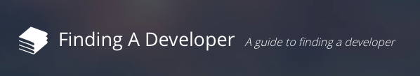
Guide to Finding a
Software Developer
December 31, 20XX

Slide 39
1 - Value Proposition
Exactly what problem are we trying to solve?
There are people who have their own ideas for new websites and/or mobile products but who lack any under-standing of what it takes to build them and therefore don’t know where to begin.
There are people who have their own ideas for new websites and/or mobile products but who lack any understanding of what it takes to build them and therefore don’t know where to begin.
  They are looking for guidance from a trusted source to help them understand their options and possibly even navigate through their chosen path.
  These people often make the assumption that they have to hire a developer to move forward with their idea.
Some of the customers may not actually need a developer and would discover that by consuming the product.
Small Potatoes Studio was founded, in part to help people who are unfamiliar with software development get their software/product ideas built.
Notes:
Value Proposition

Slide 40
2 - Target Market
For whom do we solve that problem?
New, small-scale entrepreneurs, bootstrapping business owners, and business-minded creative types/tinkerers
College and even high school students
Stay at home parents
New, small-scale entrepreneurs; bootstrapping business owners; and business-minded creative types/tinkerers
  These people are serious about their idea (not just daydreaming). They have a bug and are eager to make some progress.
  It is quite possible that they have already gone down the path of trying to do it on their own and failed.
College and even high school students
  Especially with the rise of and their own familiarity with mobile products
Stay at home parents
  Moms especially, likely to be more humble, start small, do-it-yourself
    Vs. men who might bite off too much
  Tinkering on the side but don’t have a lot of time to invest
Notes:
Target
Market

Slide 41
3 - Market Size
How big is the opportunity?
Prospects are likely to number in the 100,000s
Have every reason to believe this is a worldwide problem although likely to target English-speaking population initially.
  Filters
    People who haven’t yet launched their idea
    People already considering investing money in their idea
Prospects are likely to number in the 100,000s
Notes:
Market
Size

Slide 42
4 - Business Metrics / Revenue Strategy
How will we measure success?
Small Potatoes is primarily interested in generating passive revenue from these offerings and has set a minimum target of a low 5-figure return.
Small Potatoes is primarily interested in generating passive revenue from these offerings and has set a minimum target of a low 5-figure return.
  Will track the following
    Revenue per customer
    Total revenue
Notes:
Business Metrics / Revenue Strategy

Slide 43
5 - Competitive Landscape
What alternatives are out there now?
It is likely that most prospects are:
  Doing nothing and/or give up
  Muscling through themselves
  Looking to friends/family for informal advice
Prospects are exploring self-help options to ramp up including books and magazines as well as a growing number of online options including articles, blog posts, and even full tutorials.
There are dedicated websites for would-be entrepreneurs and bootstrappers that address this topic.
Prior to discovering Small Potatoes’ offerings, it is likely that most prospects will have already gone down one of these paths:
  Do nothing and/or give up, concluding that it is just too hard
  Muscle through themselves
  Look to friends/family for informal advice
Prospects are exploring self-help options to ramp up on specific tools/products including both physical artifacts like books and magazines and a growing number of online options including articles, blog posts, and even full tutorials.
  E.g. “Learn MS Excel”, “Launch your online business in 15 days”, “WordPress for Dummies”
  It is very easy and quite common for “experts” to provide advice on this topic, usually offered for free on individual blogs, and often discovered via search engines.
  Small Potatoes believes that the majority of these articles are “opaque”, written by tech authors who have difficulty effectively communicating with the target audience.
There are dedicated websites for would-be entrepreneurs and bootstrappers that address this topic.
  Wordpress tutorial sites
    Do’s And Don’ts For WordPress Startups
    https://www.udemy.com/how-to-build-your-own-online-business/
  Guru.com
  eLance.com
  Bootstrapper sites
Notes:
Competitive
Landscape

Slide 44
6 - Our Differentiator
Why are we best suited to pursue this?
The founder has more than 15 years of industry experience.
He has established significant credibility in this exact area.
The founder/ author has the proven ability to communicate technical ideas to a non-technical audience.
The founder of Small Potatoes Studio has more than 15 years of industry experience locating, hiring and onboarding software developers into businesses of all sizes.
The founder has established significant credibility in this exact area, having helped dozens of individual entrepreneurs and small businesses address this problem.
  Small Potatoes will be able to acquire suitable references to help with credibility.
  Small Potatoes will likely generate and share case study examples from past customers to further establish credibility.
The founder and author for this collateral has the proven ability to communicate technical ideas to a non-technical audience.
Notes:
Our Differentiator

Slide 45
7 - Market Window
Why now?
New businesses are on the rise thanks to new models.
There is significant interest around the idea starting your own company.
This has created an increased demand for software developers but has not been matched on the supply side.
With good information more scattered than ever, there is an opportunity to aggregate, distill, and present a definitive guide for info seekers.
Small Potatoes believes, at this point, there is significant interest around the idea starting your own company.
New businesses are on the rise and can be attributed, in no small part to the new models that are now available for building software and companies based on digital products.
  New software distribution models are attractive, especially for targeting younger audiences.
    Mobile
    Social
This has created an increased demand for software developers but has not been matched on the supply side making it even for the would-be entrepreneur/bootstrapper to find resources.
  Most good developers are already gainfully employed, further increasing the challenge for our customers of finding the right resource(s).
While it has gotten much easier for authors to contribute content on this topic, the resulting glut has continuously diluted the really useful information available to most people.
With good information more scattered than ever, there is an opportunity to aggregate, distill, and present a definitive guide for info seekers.
Notes:
Market
Window

Slide 46
8 - Go to Market Strategy
How will we get this product to market?
Launch a dedicated site for the book
Create a secondary site/product promotion
Also consider viral techniques to promote the product including referral and affiliate links
Small Potatoes plans to launch a dedicated site at FindingADeveloper.com where prospects can learn about and purchase the product(s).
  The site will invest in keywords and similar tactics to attract SEO traffic from search engines.
  Small Potatoes is considering investing in paid Google ads as well as Facebook ads to drive traffic to the site.
Secondary site/product promotion
  Guest blogging
  Speaking opportunities
  Sponsorships
  Social network outreach
  Guest podcasting
Small Potatoes has also considered several viral techniques to promote the product(s).
  Providing free and/or discounted “stuff” for inbound referrals
  Creating and sharing affiliate links to reward others who promote the products.
Notes:
Go to Market
Strategy

Slide 47
9 - Solution Requirements
What factors are critical to success?
First, deliver an eBook that explains how to hire a software developer.
Follow up with ongoing subscription service to provide access to related digital collateral
Also consider
  Packages of document templates
  Additional consumable media artifacts
  Consultation services
  Free, "lite" version delivered as an email/auto-responder course
eBook that explains how to hire a software developer.
  Easy to buy, easy to consume
    Delivered as standalone product, digital version only
    No additional subscriptions required for supplemental content
Ongoing subscription service to gain access to related digital collateral
  Instructional videos for navigating certain activities
    E.g. How to set up your Elance project
Packages of document templates
  E.g. standard contracts and agreements like MSA, NDA
  Typical documents used when engaging developers (e.g. SOW, requirements spec, sitemaps, …)
Additional consumable media artifacts
  Audio/video interviews with CTOs & other entrepreneurs who have gone down this path, sharing tips/tricks, best practices, and pitfalls.
Consultation services
  Schedule one-on-one time with the founder/author and/or cohorts
Free, "lite" version delivered as an email/auto-responder course
  Marketing campaign
Notes:
Solution
Requirements

Slide 48
Go or No-Go
Our recommendation
There is a need (i.e. a market); the pain is well-defined and understood.
Small Potatoes has the experience & reputation to address the problem.
Small Potatoes has the ability to reach the target market and to successfully deliver a product that can be consumed by the customer.
The “info products” revenue model is sound but will need to look for early validation that customers will pay for this particular product
  It is still unproven whether the customer will pay and if so, how much to acquire this knowledge from Small Potatoes.
  It is unproven whether the eBook customer will seek out and pay for additional solutions from this same vendor.
  Unclear whether Small Potatoes can reach its target revenue goals of low five figures.
Notes:
Go or
No-Go

Slide 49

Go/No-Go
Tips & More
Additional information on using the Multi-Tool is available at theProductPath.com
© 2023 theProductPath

Slide 50
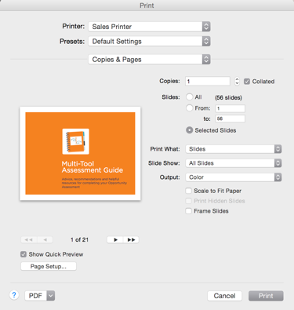
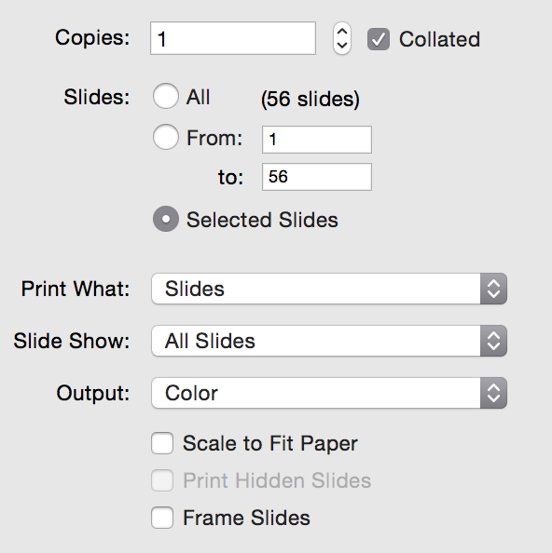
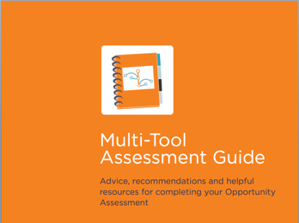
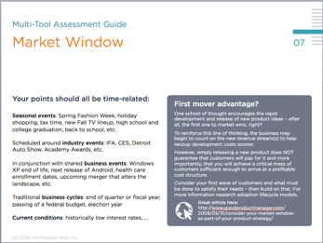
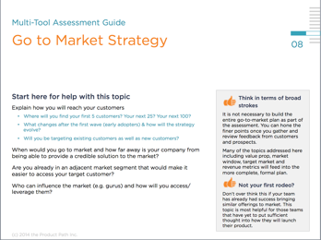
Tip #1: Print the Assessment Guide
Share the Assessment Guide with each collaborator
Use PowerPoint’s Print function
Select only the slides for Assessment Guide
The Guide is organized to match the 10 elements of the Opportunity Assessment
Extensive notes are included for each Assessment slide
© 2023 theProductPath

Slide 51
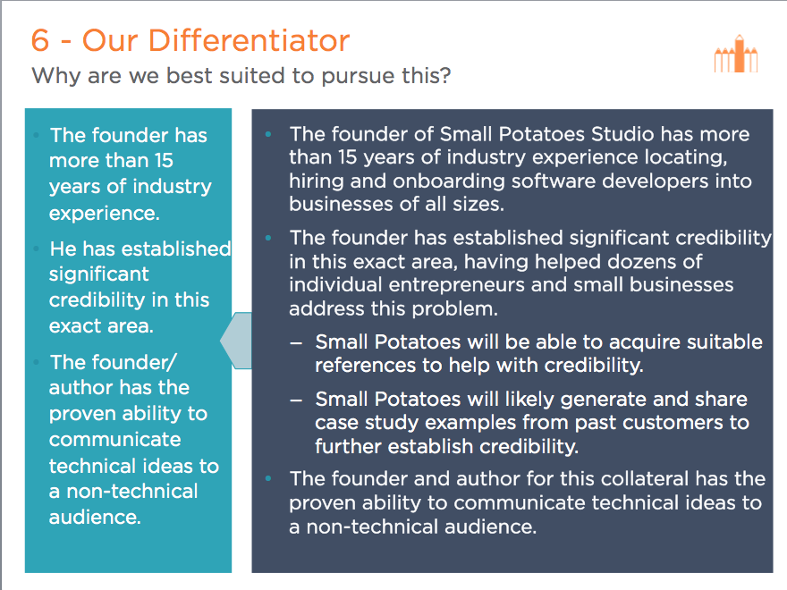
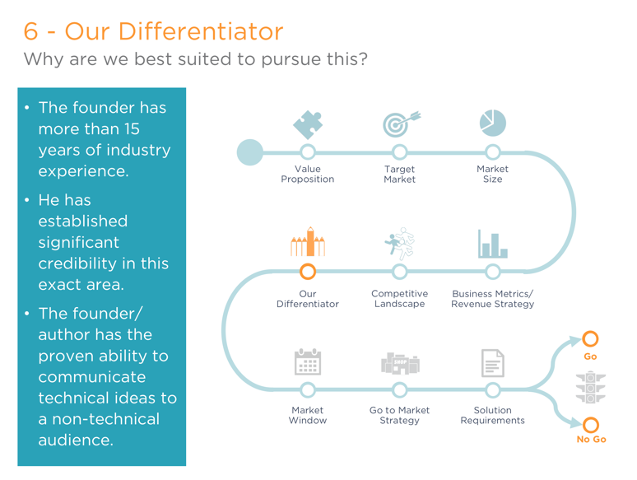
Tip #2: Presenting your results
The Multi-Tool is optimized for sharing as slideshows – use the included example to see how it works.
⬅Slide view displays your notes
Presentation view hides them ➔
Make the title slide attractive and engaging
Rehearse your presentation to understand how it will flow both forwards and backwards
The Assessment graphic on each slide tracks your progress during the presentation and also serves as a navigational tool to jump among the topics.
© 2023 theProductPath

Slide 52
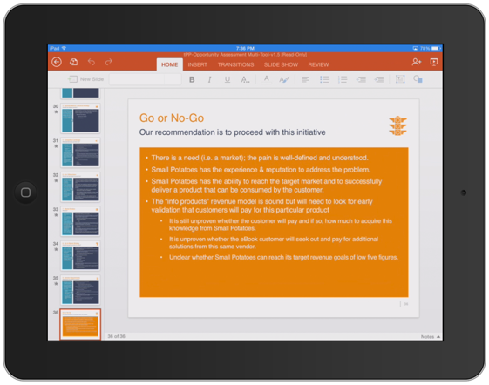
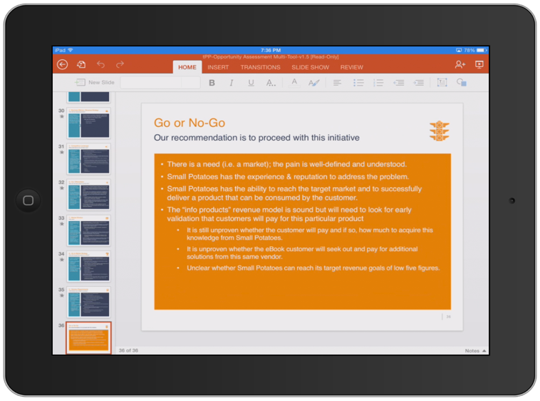




Tip #3: Mobile presentations
Tablets are ideal for sharing your results outside of the office
Slide view
Prefer tablets to smartphones
Be sure to test all slide animations and hidden slides
Avoid applications that do not treat PPT files natively (e.g. Dropbox, Box, Google Drive)
Microsoft’s PowerPoint for iPad is free for iOS and most replicates the desktop experience.
Microsoft also offers PowerPoint on Android devices for free.
Presentation view
© 2023 theProductPath

Slide 53
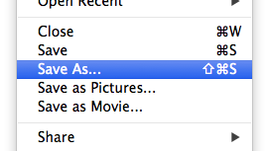
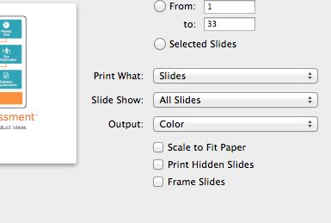
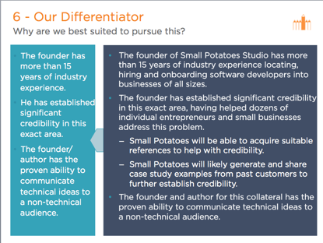

Tip #4: Print your Assessment
Note: the Multi-Tool is optimized for capture and presentation, not for printing. Many of the supporting slides can be hidden (or deleted).
For best results, save a copy of the presentation that you can safely modify before printing the slides.
In your new copy, hide (or delete) any of the slides you don’t want to print.
PowerPoint has a printing option that skips hidden slides.
If desired, remove the larger “scratchpad” text boxes on each slide to reveal the underlying graphic.
© 2023 theProductPath

Slide 54
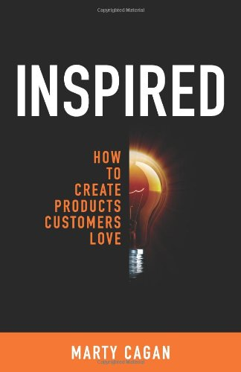

Inspiration Acknowledgement
This work is derived from the book Inspired by Marty Cagan
Created by Steven Jones, Founder of
For more, visit theProductPath.com

Slide 55



When do I use the Go/No-Go Multi-Tool?
12 reasons why you want this in your tool belt
For Product Managers
We recommend
Need to prioritize some big items on your product roadmap?
Get the team together to quickly assess each of your big ticket items.
Watch the best opportunities rise to the top.
Do you need to defend an earlier product decision that was never formalized?
A retroactive assessment can add value when the original argument has lost its strength.
Build and justify your case to gain better alignment.
Are you considering a sizable upcoming product investment?
Complete a thorough assessment and don’t cut corners with any of your answers.
Increase your confidence before you get too far in.
Are you growing the project team and need to onboard new members?
Formalize the answers you already know and include in the new hire training.
Provide a concise reference as pre-requisite reading.
© 2023 theProductPath

Slide 56
When do I use the Go/No-Go Multi-Tool?
12 reasons why you want this in your tool belt
For Product Managers
We recommend
Do you need to put to rest the nagging product suggestions that won’t go away?
The assessment provides a formal “speed bump” for half-baked ideas.
Easily expose weaknesses in ill-conceived proposals.
Do you need to downsize and having trouble picking which projects to pause?
Good assessments help you size each opportunity so you can make fair comparisons.
Time-sensitive opportunities may take precedence.
For Executives
We recommend
Are you taking over an existing project and need to get your bearings?
Use the assessment format to collect answers as you interview with the team(s).
The exercise can serve as a good bellwether for all.
Do you have entrepreneurial-minded folks on your team blurting out “good ideas”?
Have your go-getter fill out the assessment before pitching their latest brainstorm.
Highlight the need for qualification and lead by example.
© 2023 theProductPath

Slide 57
When do I use the Go/No-Go Multi-Tool?
12 reasons why you want this in your tool belt
For Entrepreneurs
We recommend
Have you been mulling over
or tinkering with a new idea
for more than a few weeks?
Take an hour to fill out the 1-page template
for your idea.
Stop wondering if your idea truly has merit.
Are you in pretty far already and having second thoughts with the current initiative?
Use the assessment exercise to revisit your assumptions.
Rediscover your motivation and regain your focus.
Are you pitching your big idea to would-be investors and
need to be better prepared?
The assessment is a good due diligence tool to build the strongest case for your idea.
Score high marks with any business-oriented audience.
Are you writing your first business plan and need a
head start?
The Opportunity Assessment is a stepping stone to a more formal plan.
Cover much of the same territory in this brief format.
© 2023 theProductPath

Slide 58
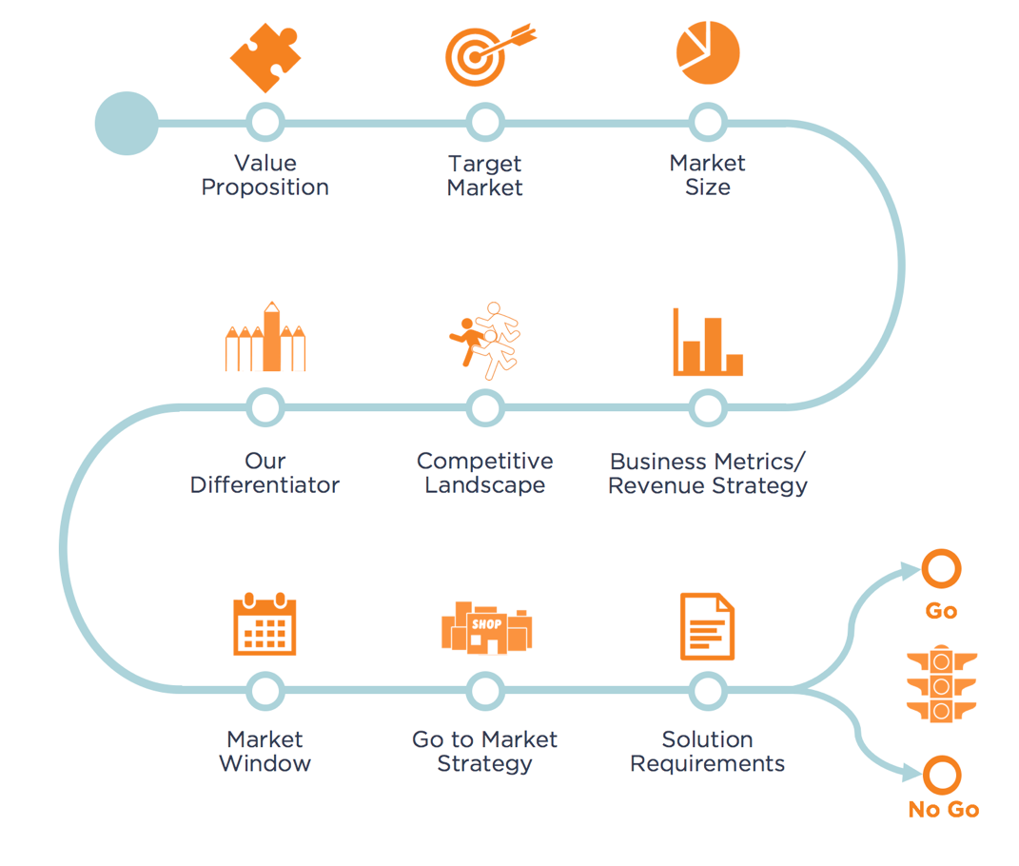
Praise for the Assessment Multi-Tool
“
Our team needed a more systematic approach for evaluating all the new product ideas coming in from customers and our executive team. We found that the Multi-Tool allowed us to quickly assess these opportunities and to make better data-based decisions about the product roadmap.
- Victor
Product Marketing Manager
for SpringCM
”
For more help with your Assessments, visit theProductPath.com

